Slide 1
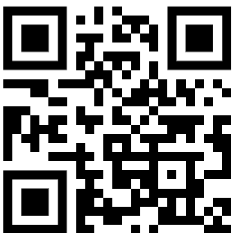
MASTER CLASS ARCHITECTING and DEVELOPMENT CUSTOM AGENTS
Dr. Damir Dobric
Lead Software Architect daenet GmbH / ACP Digital
Microsoft Regional Director,
Most Valuable Professional: AI

Slide 2
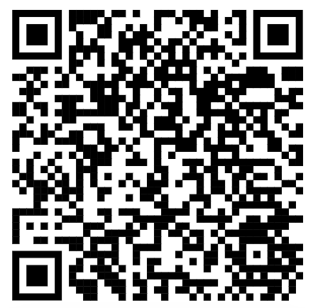
See github repo
https://github.com/ddobric/semantic-kernel-training
https://tinyurl.com/49tf9346

Slide 3
10:45-11:15
13.00-14.00
15:45-16:15

Slide 4
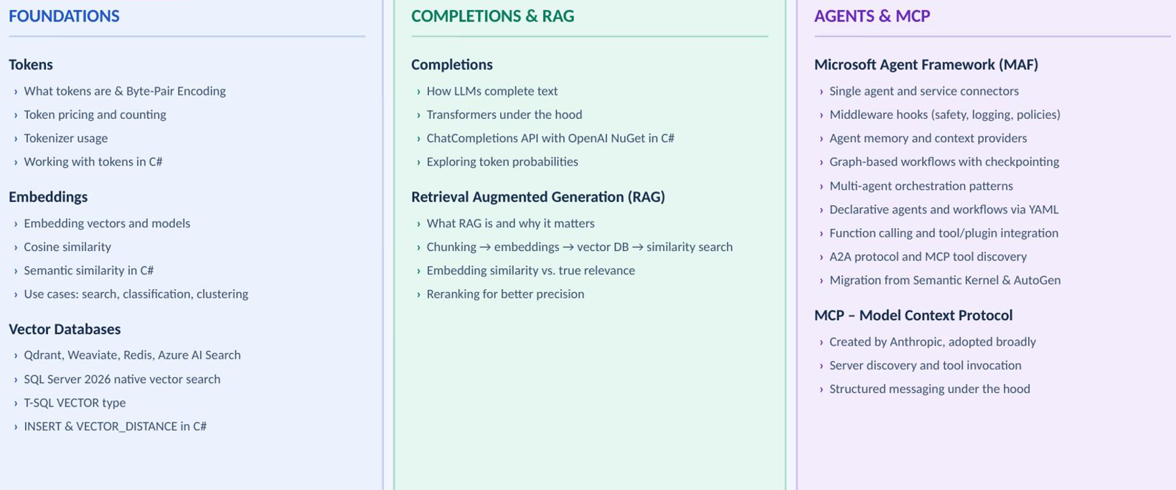
AGENDA

Slide 5
Diverse Services
Open AI
https://platform.openai.com/docs/models
Mistral AI Studio - Mistral AI Anthropic
Home \ Anthropic GEMINI Google Gemini
Azure AI Foundry https://oai.azure.com/portal/****/models https://ai.azure.com/

Slide 6
TOKENS

Slide 7
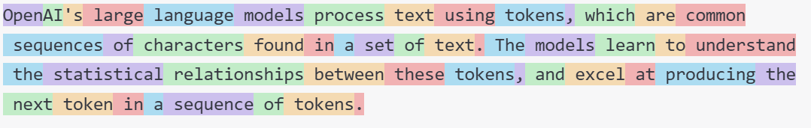
What are tokens?
1 token ~= 4 chars in English
1 token ~= ¾ words
100 tokens ~= 75 words
Byte Pare Encoding (Gage,1994): Wikipedia
What are tokens and how to count them?
Token Pricing: Pricing (openai.com)

Slide 8
Working with Tokens
Tokenizer
Creating tokens in C#
.\src\SKTrainingSolution\semantickernelsample: WorkingWithTokens

Slide 9
EMBEDDINGS

Slide 10
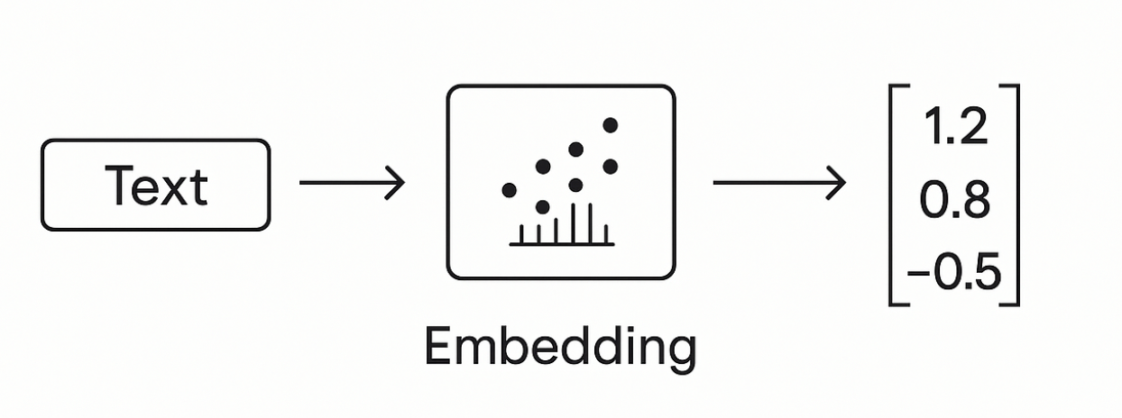
What is embedding Vector?

Slide 11
Embedding Models
Guess, today is a nice day in Palma
Today is a typical German rainy day
Two things are infinite: the universe and human stupidity; and I'm not sure about the universe.

Slide 12
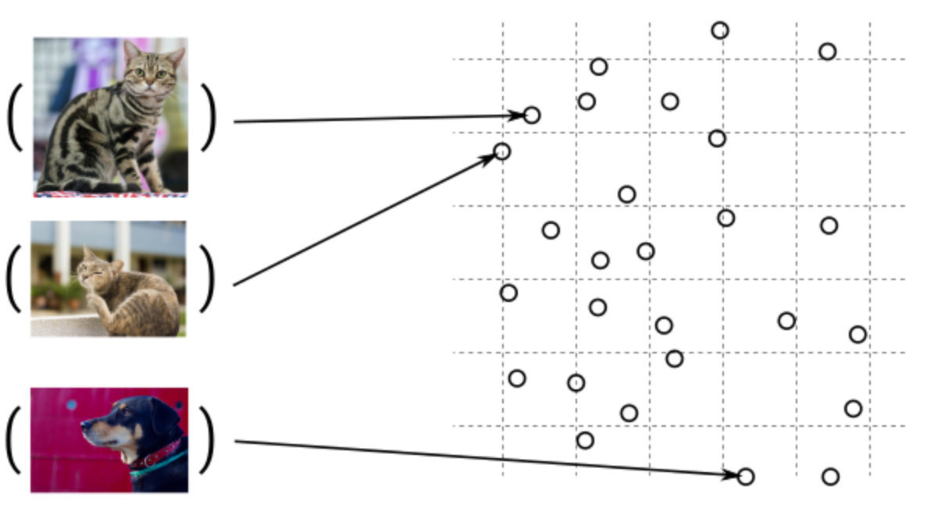
Embedding Models

Slide 13

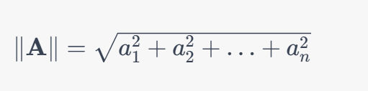

The Cosine Similarity
Dot Product
The Norm
Cosine Similarity

Slide 14
DEMO
Consuming Embedding Model with HTTP/Post
Creating Embeddings in C#
Semantic Similarity
.\src\OpenAI.Samples\Program.cs Sample: CreateEmbeddingsAsync()
.\src\OpenAI.Samples

Slide 15
When to use embeddings?
Semantic Search
Classification
Clustering
Recommendations
. . .

Slide 16
VECTOR DATABASES

Slide 17
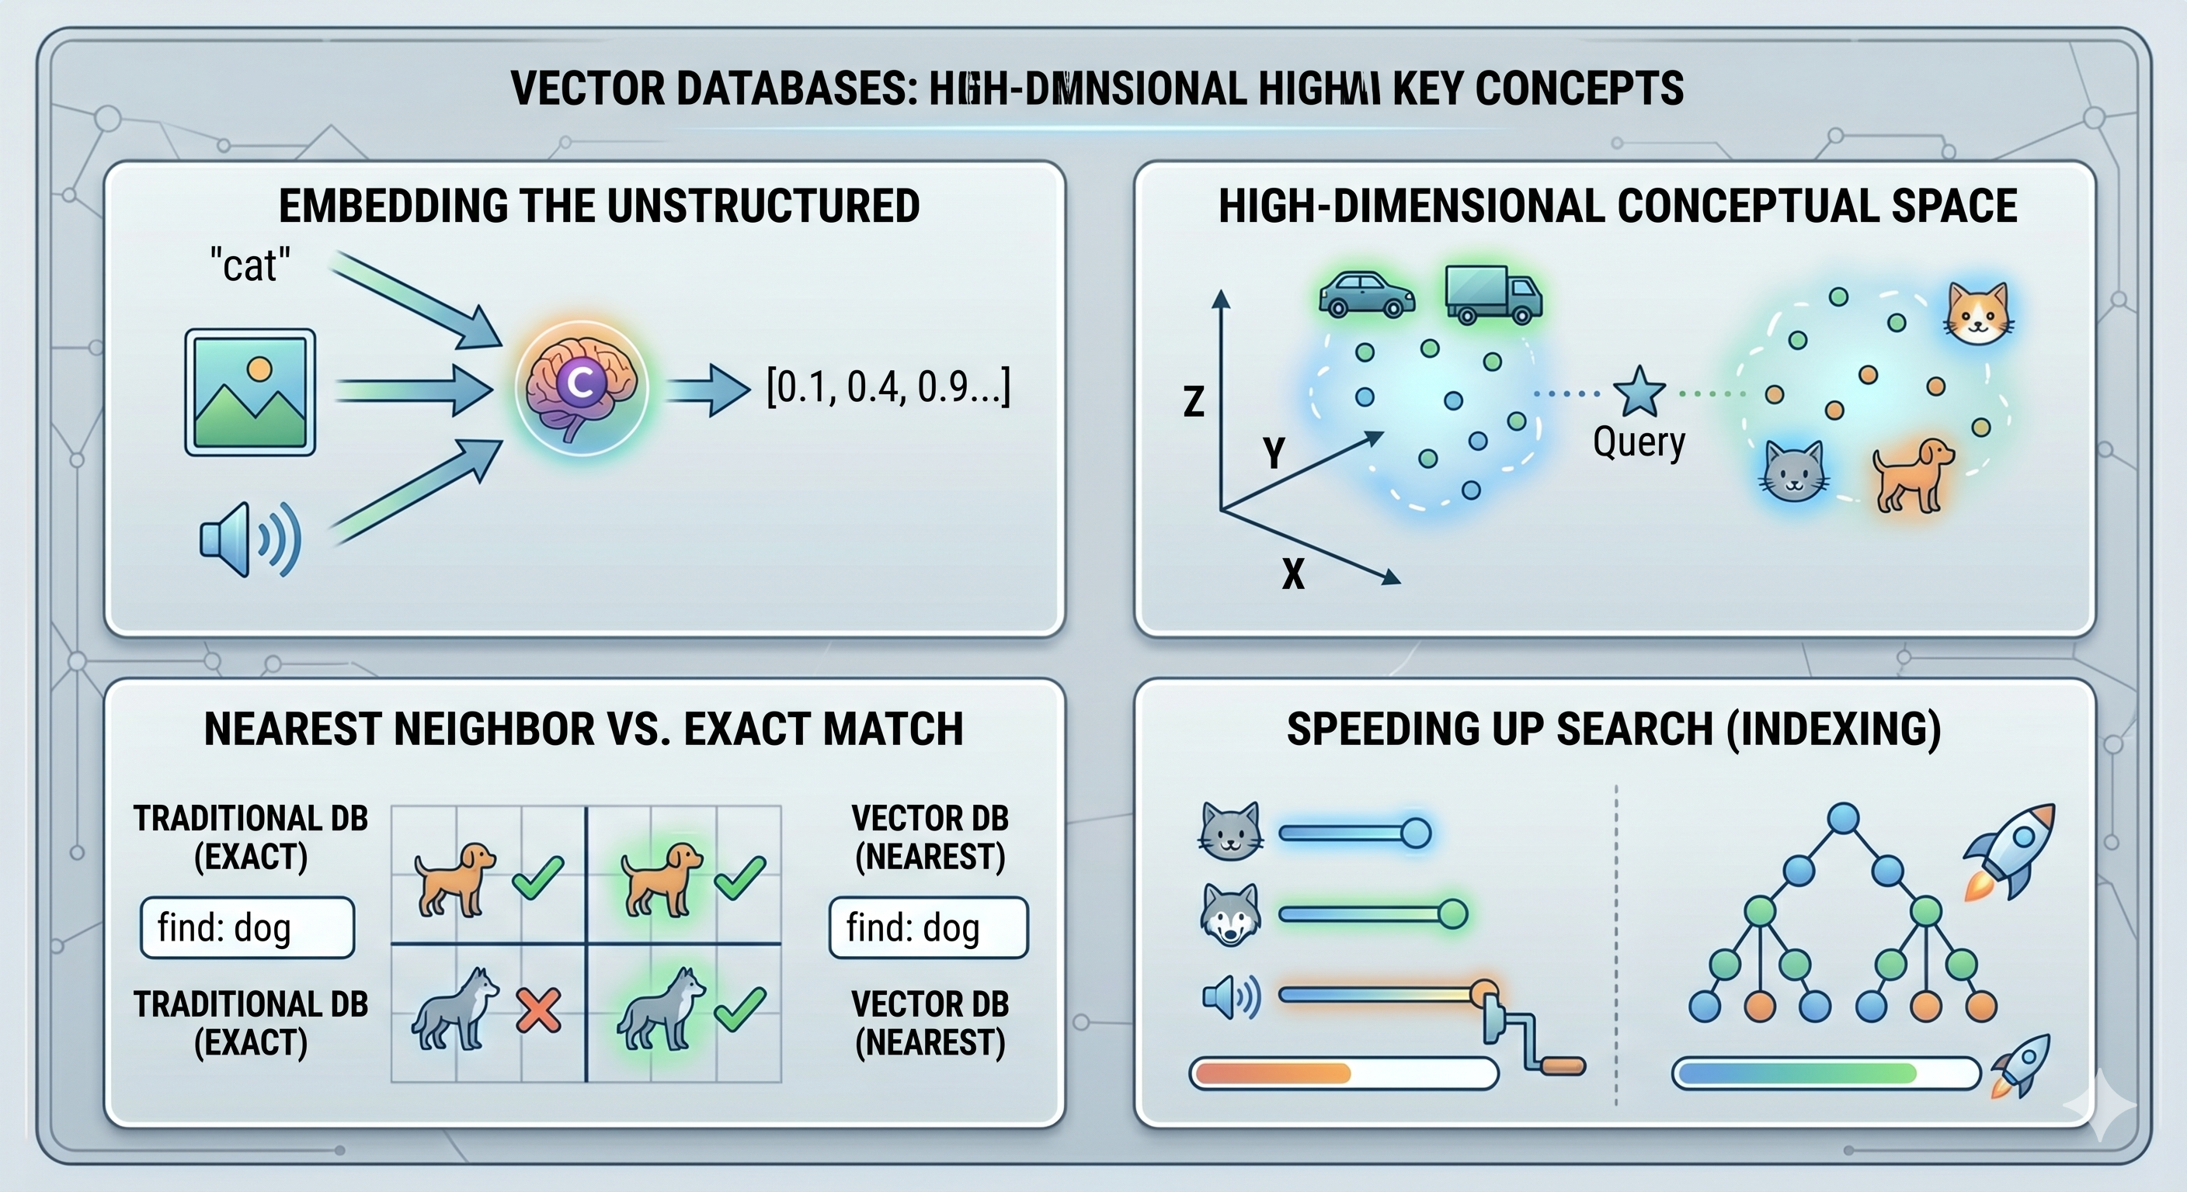

Slide 18
Popular Vector Databases
SQL Server 2026 Native Vector Search
Pinecone
Weaviate
Milvus
Qdrant
PostgreSQL + pgvector
MongoDB Atlas
Elasticsearch
Redis
Azure AI Search
Vertex AI Matching Engine
Amazon OpenSearch Service
Databricks Vector Search
Chroma
FAISS
Annoy
ScaNN

Slide 19
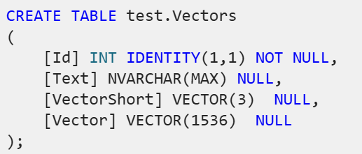
SQL Server Native Vector Search
SqlServer 2025 Native Vector Search
In Azure
On-Prem
SQL Server Native Vector Search for .NET Developers

Slide 20
Working with the Vector T-SQL and C#
SqlCommand command = new SqlCommand($"INSERT INTO [test].[{_cTableName}] ([Vector], [Text]) VALUES (@Vector, @Text)", connection);
command.Parameters.AddWithValue("@Vector", new SqlVector<float>(float[]{…}));

Slide 21

Can be used as JSON [OBSOLETE!!!] ADO.NET Driver v<6.1.0
sqlCmd.Parameters.AddWithValue("@Vector", JsonSerializer.Serialize(new float[] { 1.12f, 2.22f, 3.33f }));
sqlCmd.Parameters.AddWithValue("@Vector", ‘[1.12, 2.22, 3.33]’);

Slide 22
Insert and Query by VECTOR Cosine Distance
DECLARE @e1 VECTOR(5) = '[1.1, 2.2, 3.3, 4.4, 5.5]';
DECLARE @e2 VECTOR(5) = '[6.1, 7.2, 8.3, 9.4, 10.5]';
DECLARE @e3 VECTOR(5) = '[11.1, 12.2, 13.3, 14.4, 15.5]';
DECLARE @e4 VECTOR(5) = '[11.1, 12.2, 13.3, 14.4, 15.5]';
DECLARE @e5 VECTOR(5) = '[16.1, 17.2, 18.3, 19.4, 20.5]';
DECLARE @e6 VECTOR(5) = '[21.1, 22.2, 23.3, 24.4, 25.5]';
DECLARE @e7 VECTOR(5) = '[1.1, 2.2, 3.3, 4.4, 5.0]';
INSERT INTO dbo.SampleVectors ([Vector]) VALUES (@e1 )
INSERT INTO dbo.SampleVectors ([Vector]) VALUES (@e2 )
INSERT INTO dbo.SampleVectors ([Vector]) VALUES (@e3)
INSERT INTO dbo.SampleVectors ([Vector]) VALUES (@e4)
INSERT INTO dbo.SampleVectors ([Vector]) VALUES (@e5)
INSERT INTO dbo.SampleVectors ([Vector]) VALUES (@e7)
Select * from dbo.SampleVectors
DECLARE @e0 VECTOR(5) = '[1.1, 2.2, 3.3, 4.4, 5.0]';
SELECT VECTOR_DISTANCE('cosine', @e0, Vector) AS Distance, * FROM dbo.SampleVectors ORDER BY Distance;

Slide 23
Different Distance Calculations
DECLARE @v1 VECTOR(2) = '[1,1]';
DECLARE @v2 VECTOR(2) = '[-1,-1]';
SELECT
VECTOR_DISTANCE('euclidean', @v1, @v2) AS euclidean,
VECTOR_DISTANCE('cosine', @v1, @v2) AS cosine,
VECTOR_DISTANCE('dot', @v1, @v2) AS negative_dot_product;

Slide 24
DEMO SQL Native Vector Search
devblogs.microsoft.com/azure-sql/sql-server-native-vector-search-for-net-developers/ Corner

Slide 25
COMPLETIONS

Slide 26
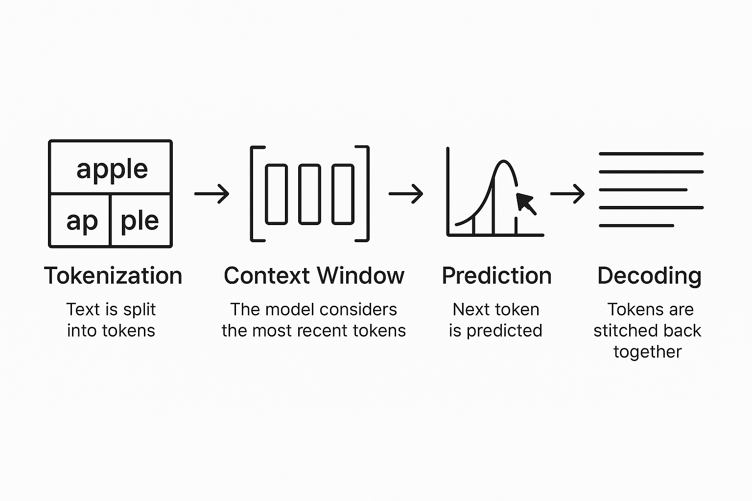
LLMs Complete Text

Slide 27
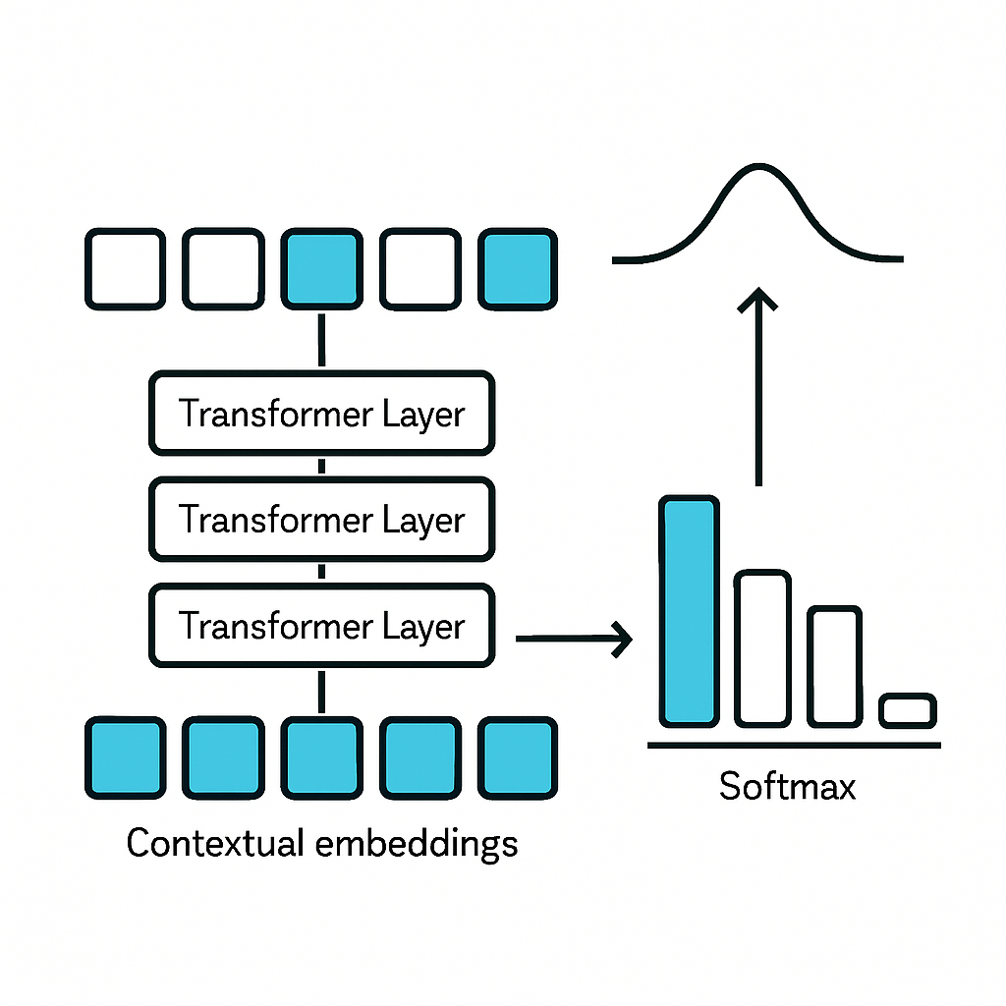
Transformers

Slide 28
Completing Text Under the hub
C# Application
Using OpenAI nuget package
Executing ChatCompletions
Presenting Probabilities
.\src\OpenAI.Samples Sample: ChatCompletionsAsync

Slide 29
Retrieval Augmented Generation R A G

Slide 30
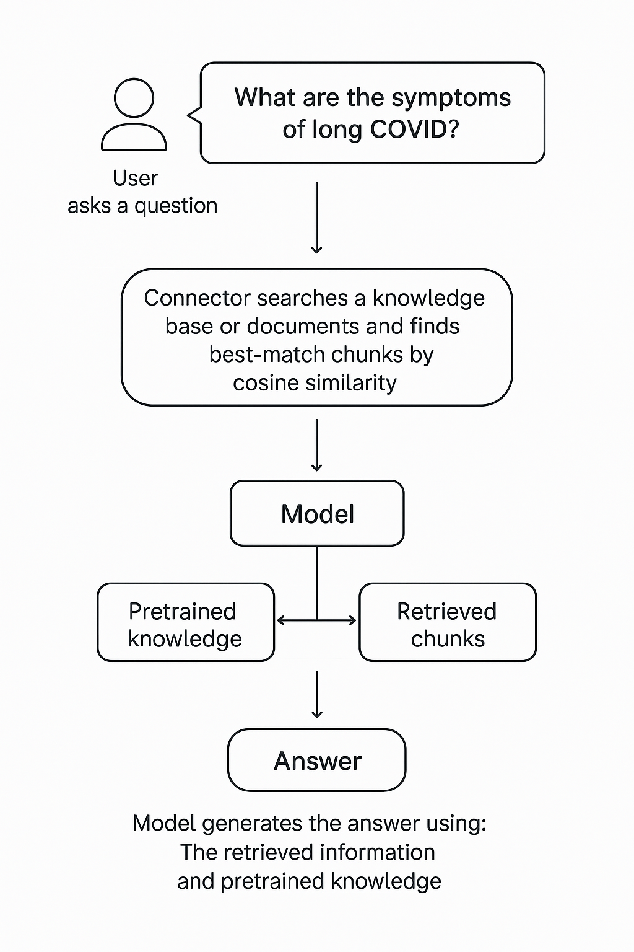
What is RAG?
Extending the model knowledge
Combines information retrieval with text generation
https://arxiv.org/abs/2005.11401

Slide 31
RAG Demos
Creating chunks
Creating embeddings
InMemory Vector DB
Calculating Similarity
.\src\SKTrainingSolution\semantickernelsample\ Samples: RagSample.cs

Slide 32
The problem with RAG
In a typical RAG pipeline:
You convert a query into an embedding
You search a vector database for similar embeddings
You retrieve the top k chunks (e.g., top 5 or 10)
The issue: 👉 Embedding similarity ≠ true relevance
Why?
Embeddings capture semantic similarity, not exact intent
They can miss nuance (negation, context, specificity)
You often get “kind of related” chunks instead of “exactly what you need”

Slide 33
Reranking
Reranking = a second, smarter filtering step
After retrieval:
You take the top k candidates (e.g., 20 chunks)
You pass them—together with the query—into a reranker model
The model scores each chunk based on actual relevance to the query
You keep the best n (e.g., top 3–5)
Score how relevant this document is to the query from 3-5

Slide 34
RAG Demos
Creating chunks
Creating embeddings
InMemory Vector DB
Calculating Similarity

Slide 35
AGENTS Microsoft Agent Framework

Slide 36
MAF Important Topics
Single Agent and Service Connectors
Middleware Hooks
Agent Memory and Context Providers
Agent Workflows
Multi-Agent Orchestration
Declarative Agents and Workflows (YAML)
A2A, and MCP
Migration Assistants (Semantic Kernel and AutoGen)

Slide 37
MAF Important Topics 1/3
Single Agent and Service Connectors – The core agent abstraction is stable and production-ready across both .NET and Python. Agent Framework ships with first-party service connectors for Microsoft Foundry, Azure OpenAI, OpenAI, Anthropic Claude, Amazon Bedrock, Google Gemini and Ollama. [Learn more… ]
Middleware Hooks – The middleware pipeline lets you intercept, transform, and extend agent behavior at every stage of execution: content safety filters, logging, compliance policies, custom logic – all without modifying agent prompts. [Learn more… ]
Agent Memory and Context Providers – Pluggable memory architecture supporting conversational history, persistent key-value state, and vector-based retrieval. Choose your backend: Memory in Foundry Agent Service, Mem0, Redis, Neo4j or use a custom store. [Learn more…]

Slide 38
MAF Important Topics 2/3
Agent Workflows – The graph-based workflow engine for composing agents and functions into deterministic, repeatable processes is now stable. Build workflows that combine agent reasoning with business logic, branch on conditions, fan out to parallel steps, and converge results. Checkpointing and hydration ensure long-running processes survive interruptions. [Learn more… ]
Multi-Agent Orchestration – Stable support for the orchestration patterns that emerged from Microsoft Research and AutoGen: sequential, concurrent, handoff, group chat, and Magentic-One. All patterns support streaming, checkpointing, human-in-the-loop approvals, and pause/resume for long-running workflows. [Learn more…]
Declarative Agents and Workflows (YAML) – Define agents’ instructions, tools, memory configuration, and orchestration topology in version-controlled YAML files, then load and run them with a single API call. [Learn more… ]

Slide 39
MAF Important Topics 3/3
A2A, and MCP – MCP (Model Context Protocol) support lets agents dynamically discover and invoke external tools exposed over MCP-compliant servers. A2A (Agent-to-Agent) protocol (A2A 1.0 support coming soon) support enables cross-runtime agent collaboration – your agents can coordinate with agents running in other frameworks using structured, protocol-driven messaging. [Learn more…]
Migration Assistants (Semantic Kernel and AutoGen) – For teams coming from Semantic Kernel or AutoGen, migration assistants analyze your existing code and generate step-by-step migration plans. The Semantic Kernel migration guide and AutoGen migration guide provide detailed walkthroughs.

Slide 40
MAF Demos
Foundry Agents
Hosted Agents
Simple Agent
Session
src\Agents\AgentFrameworkSamples 1_HelloAgents RunAsync {Run with and without stream} RunMultiturnAsync

Slide 41
AGENTS Microsoft Agent Framework

Slide 42

User -> Model Chat iteraction
User: How are you?
(1)
AI
Prompt
(2)
Assistent: I‘m fine, how can I help you

Slide 43
Function Calling Specification
{
"type": "function",
"function": {
"name": "get_weather",
"description": "Retrieves current weather for the given location.",
"strict": true,
"parameters": {
"type": "object",
"properties": {
"location": {
"type": "string",
"description": "City and country e.g. Bogotá, Colombia"
},
"units": {
"type": ["string", "null"],
"enum": ["celsius", "fahrenheit"],
"description": "Units the temperature will be returned in."
}
},
"required": ["location", "units"],
"additionalProperties": false
}
}
}

Slide 44
Function Calling
User: Switch on the light to green.
LichtPlugin
SwitchLightOn(color)
SwitychLightOff
(1)
WeatherPlugin
ShowInfo(Location)
AI
Prompt
(2)
My Database
Tool: SwitchLightOn(green)

Slide 45
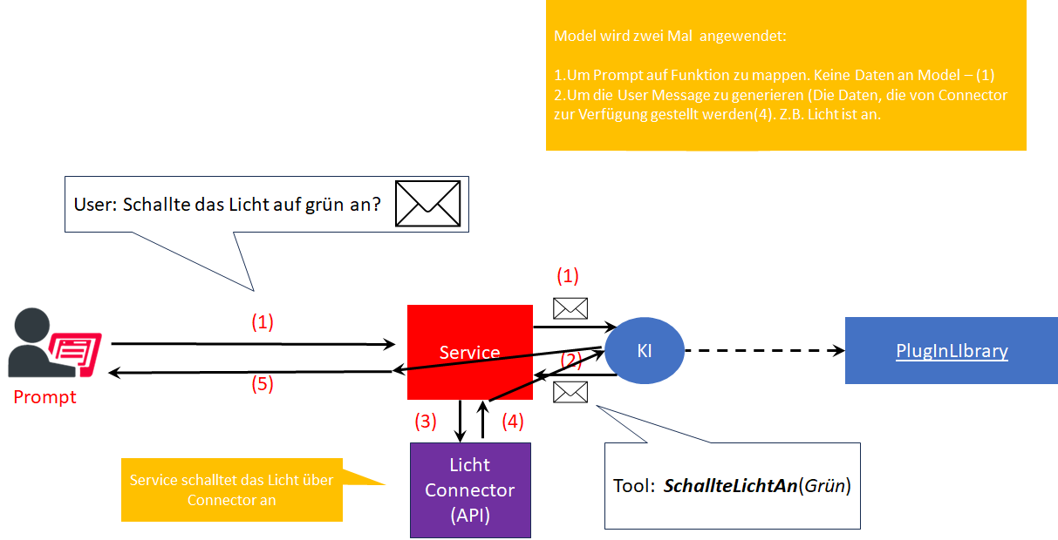
Function Calling

Slide 46
MAF Demo
Tools (Functions, Plugins)
LLM Responsibility
src\Agents\AgentFrameworkSamples 1_HelloAgents RunWithToolsAsync

Slide 47
MCP Model Context Protocol

Slide 48
MCP
Created by Anthropic Adopted by the AI community

Slide 49
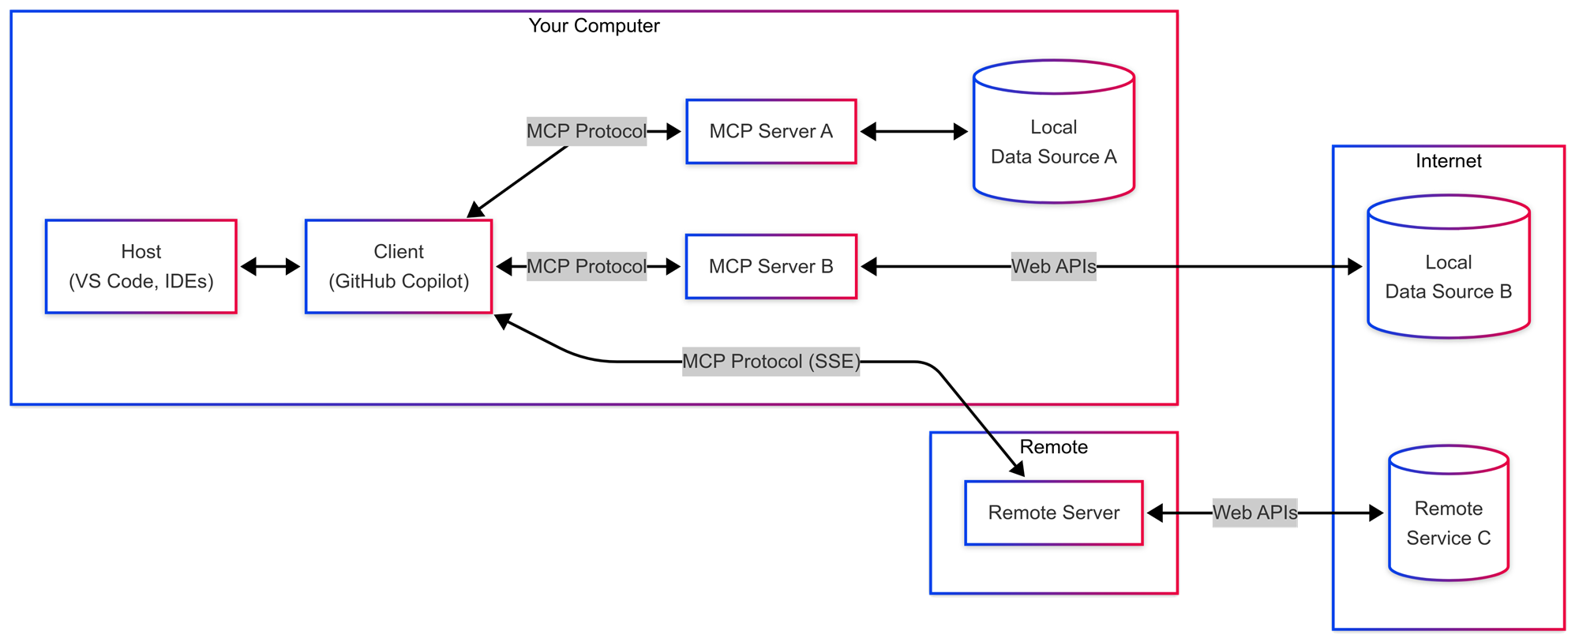
Why MCP and how does it work?

Slide 50
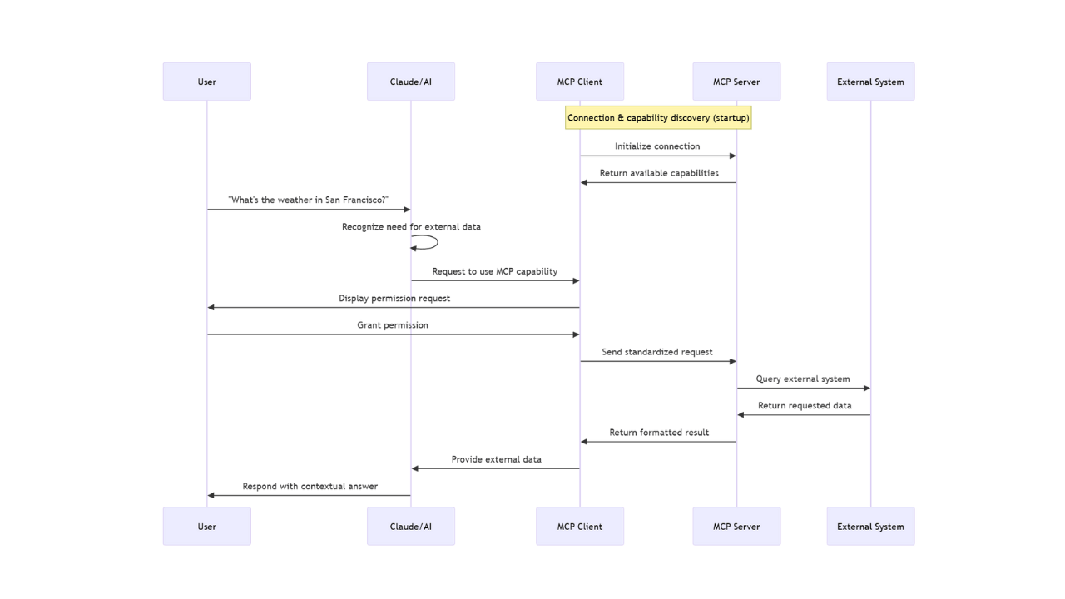
MCP under the HUB

